Slide 1
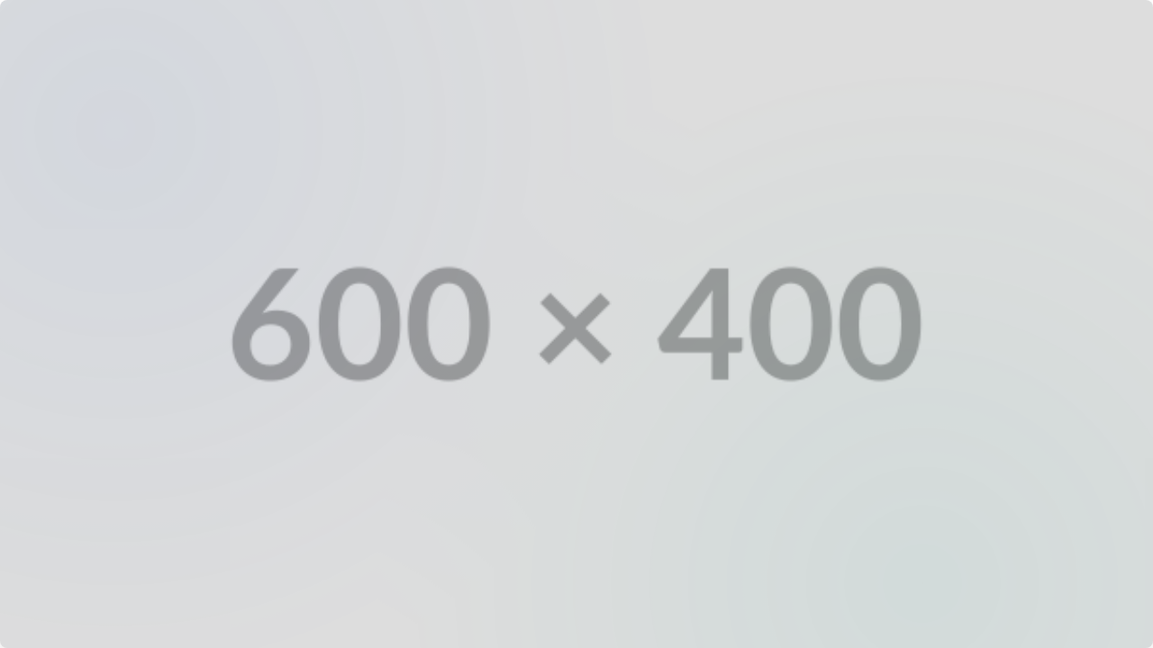

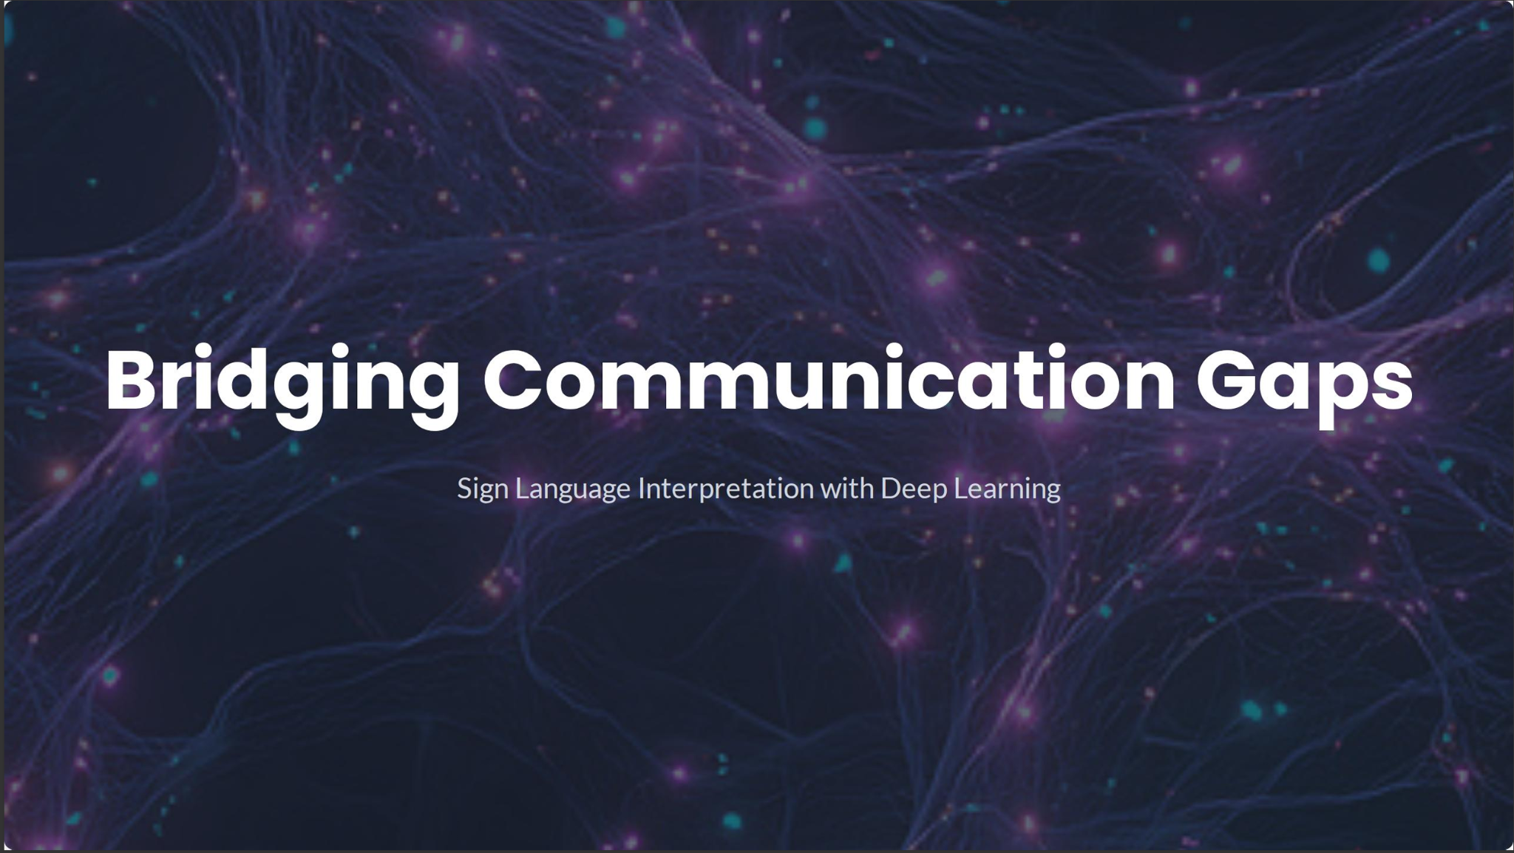
Bridging Communication Gaps
Sign Language Interpretation with Deep Learning

Slide 2



Project Overview
The Objective
The Goal
Build a Convolutional Neural Network (CNN) capable of classifying the hand signs of the American Sign Language (ASL) alphabet.
Use the trained model to accurately predict a complete line of text from a short, synthesized video input, bridging from static images to sequential decoding.

Slide 3





The ASL Alphabet Dataset
29 Classes
Perfectly Balanced
Data Split
The dataset includes all 26 letters (A-Z) plus three crucial classes for real-world use: 'del', 'nothing', and 'space'.
The data was split into 69,600 files for training (80%) and 17,400 files for validation (20%) to test generalization.
Features 3,000 images for *every* class, totaling 87,000 training images. This balance is key to the model's stable convergence.

Slide 4
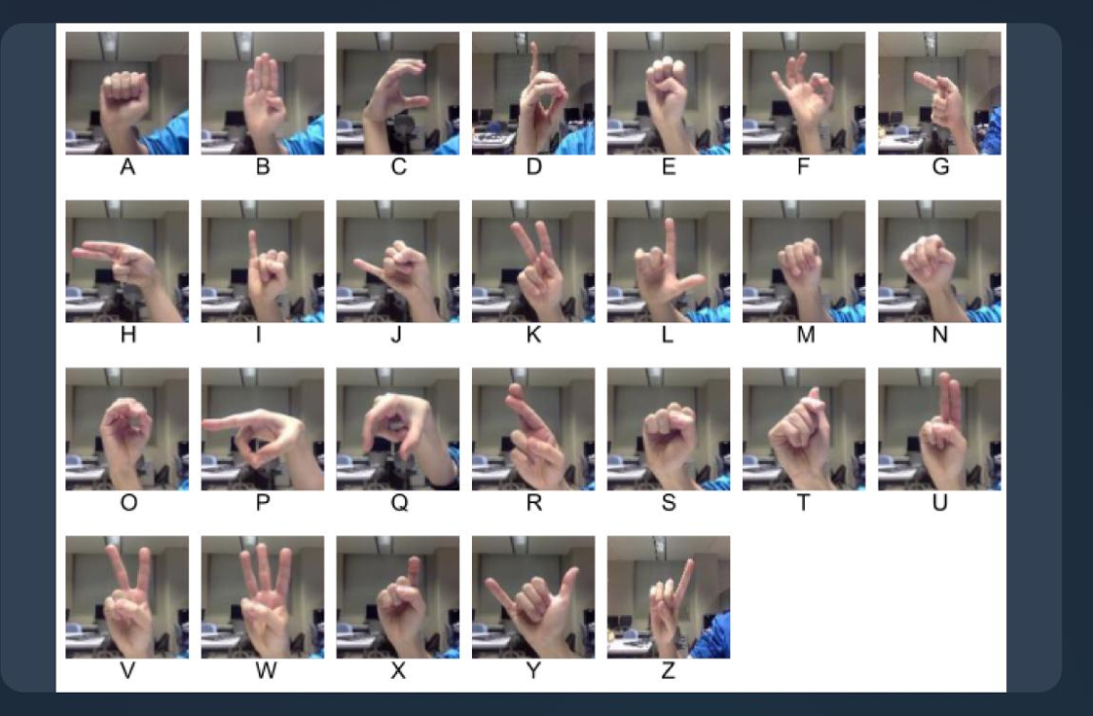

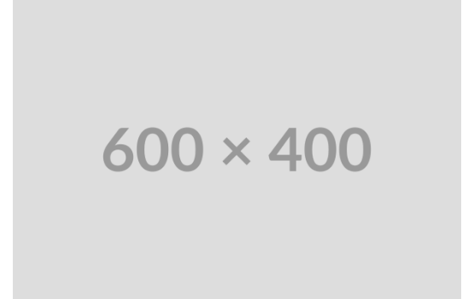
Exploratory Data Analysis
Visual Inspection
EDA confirmed the dataset's high quality and perfect class balance. This balance is a key factor in the model's rapid and stable convergence.
•
All 29 classes have exactly 3,000 images.
•
Images are clear, centered, and high-quality.
•
The clean data allows the model to focus on learning features without noise.

Slide 5
Model 1: The Baseline CNN
Architecture
Initial Result
A standard CNN with 3 Conv/MaxPool blocks, a Flatten layer, a Dense(128) layer, and Dropout (0.5) was created to establish initial performance.
Trained for only 3 epochs and we are able to achieve 91.96% accuracy.

Slide 6
Model 2: Hyperparameter Tuning
Finding the Optimal Model
We used the Keras Tuner library with the Hyperband algorithm to automatically test thousands of combinations and find the best hyperparameters.
Architecture: Tuned the number of Convolutional blocks (from 1 to 3).
Layers: Tuned filter counts, kernel sizes (3x3 or 5x5), and the number of dense units.
Learning Rate: Searched from 1e-4 to 1e-2 to find the most efficient training rate.
Objective: The tuner was optimized to find the model with the maximum validation accuracy.

Slide 7






Final Model: Tuner's Optimal Architecture
3 Conv Blocks
256 Dense Units
0.0048 LR
The tuner selected a deeper 3-block architecture with filter sizes of 32, 32, and 64, using larger 5x5 kernels for the first two.
A larger dense layer with 256 units was chosen by the tuner for the final classification head, providing more learning capacity.
A precise and relatively high learning rate of ~0.0048 combined with a 0.3 dropout rate was found to be the optimal setting.

Slide 8
Final Model: Training & Results
Training with Early Stopping
98.36%
The final model was trained for 50 epochs using Early Stopping (patience=4) to monitor `val_loss`.
This technique automatically stopped training at epoch 12 and restored the best weights from Epoch 8, preventing overfitting and ensuring the best possible generalization for the video task.
Final Validation Accuracy

Slide 9
From Frames to Words: The Decoding Pipeline
The Smart Decoding Logic
To predict a full sentence, the model doesn't just guess one frame. It uses a robust pipeline to ensure accuracy.
Predict: The stable CNN model classifies every single frame of the video.
Majority Vote: Frames are grouped by sign (1 sign per second). The most common prediction in that group becomes the chosen letter.
Space Logic: A black frame is *forced* to be a 'space'. Any 'nothing' or 'del' prediction is also converted to a 'space'.
Assemble: Repetitive letters (e.g., "S-S-S-H-H") are collapsed into one ("S H") to form the final, clean text.

Slide 10
Final Demonstration: Success!
Target Message:
"HI I AM SUSHMA I AM STUDYING IN UNIVERSITY OF COLORADO"
Decoded Message:
"HI I AM SUSHMA I AM STUDYING IN UNIVERSITY OF COLORADO"

